Slide 1

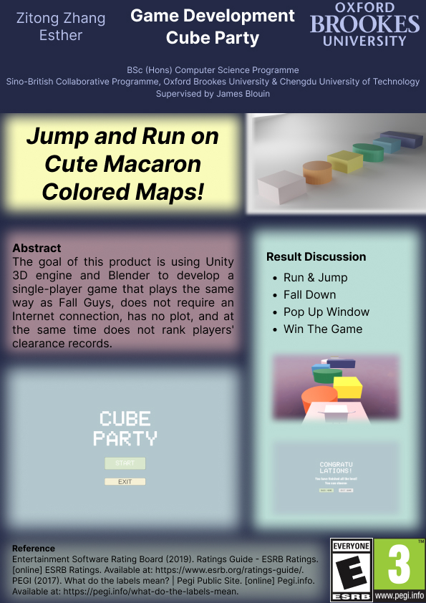
Game Development
Cube Party
Major of computer science, Chengdu University of Technology, Oxford Brookes College
Supervisor : James Blouin Student ID：201918010201 Student name：Esther

Slide 2
1
Introduction & Motivation
2
Background Review
List of Content
3
Methodology
4
Implementation & Results
5
Conclusion

Slide 3
1
Introduction & Motivation
Introduction
Movitation
PC game
Single player
Cute
Un-competitive
No rank
Love of games
Elements of the game that don't interest me
I want games that are exactly what I imagined
PEGI 3
ESRB E

Slide 4
2
Background Review
Related Game
Similarity
Differences
Each round has multiple players racing across a map at the same time
Top players in each level advance to the next level to determine a champion.
Fight alone or team up with friends
Updated seasons
Different character outfits
Different maps
Only Chinese
CADPA 8+
Mystery box
Phone game
Danzai Party
14 languages
ESRB E
More platform: Windows PC, PS4 or PS5, Switch, X Box
Fall Guys: Ultimate Knockout

Slide 5
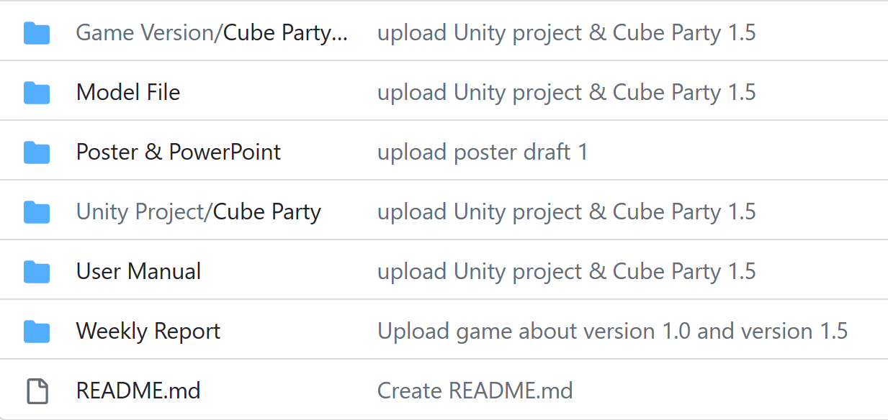
3
Methodology
Related Software
File management
Github
Notion
Implement Software
Unity
Blender
Design Software
Figma
Questionnaire tool
wjx.cn
File Management Software
Github
Github are used as backup for managing weekly reports, user manual, poster and PowerPoint, Unity project file, model file and Finished game file.

Slide 6
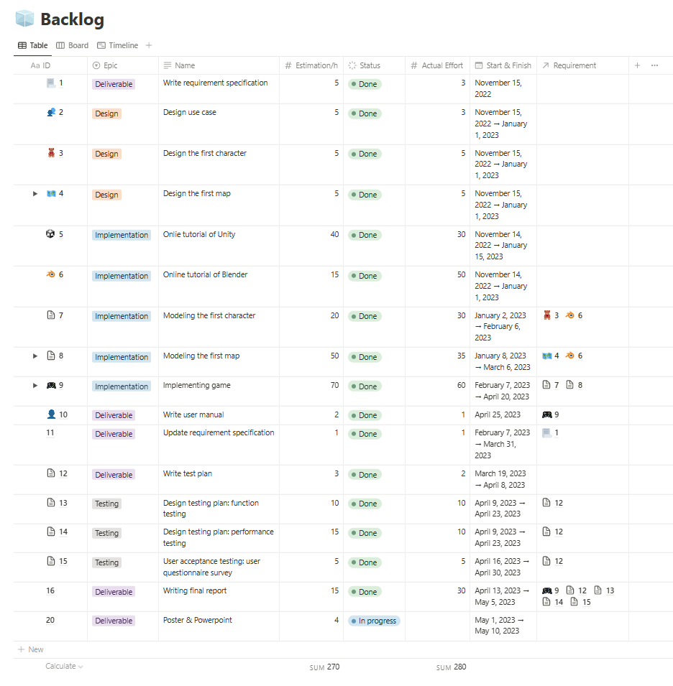
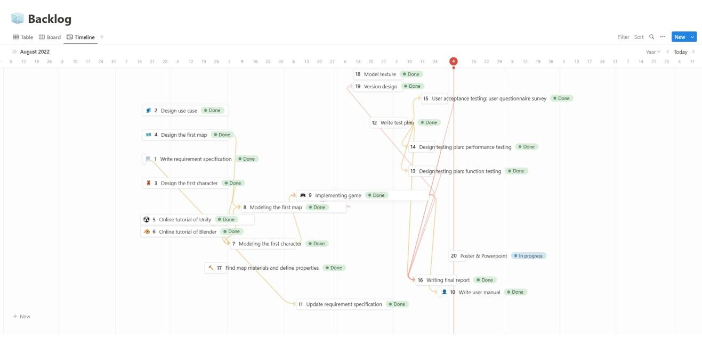
3
Methodology
File Management
Notion
The product backlog, testing documentation and so on will managed by notion

Slide 7
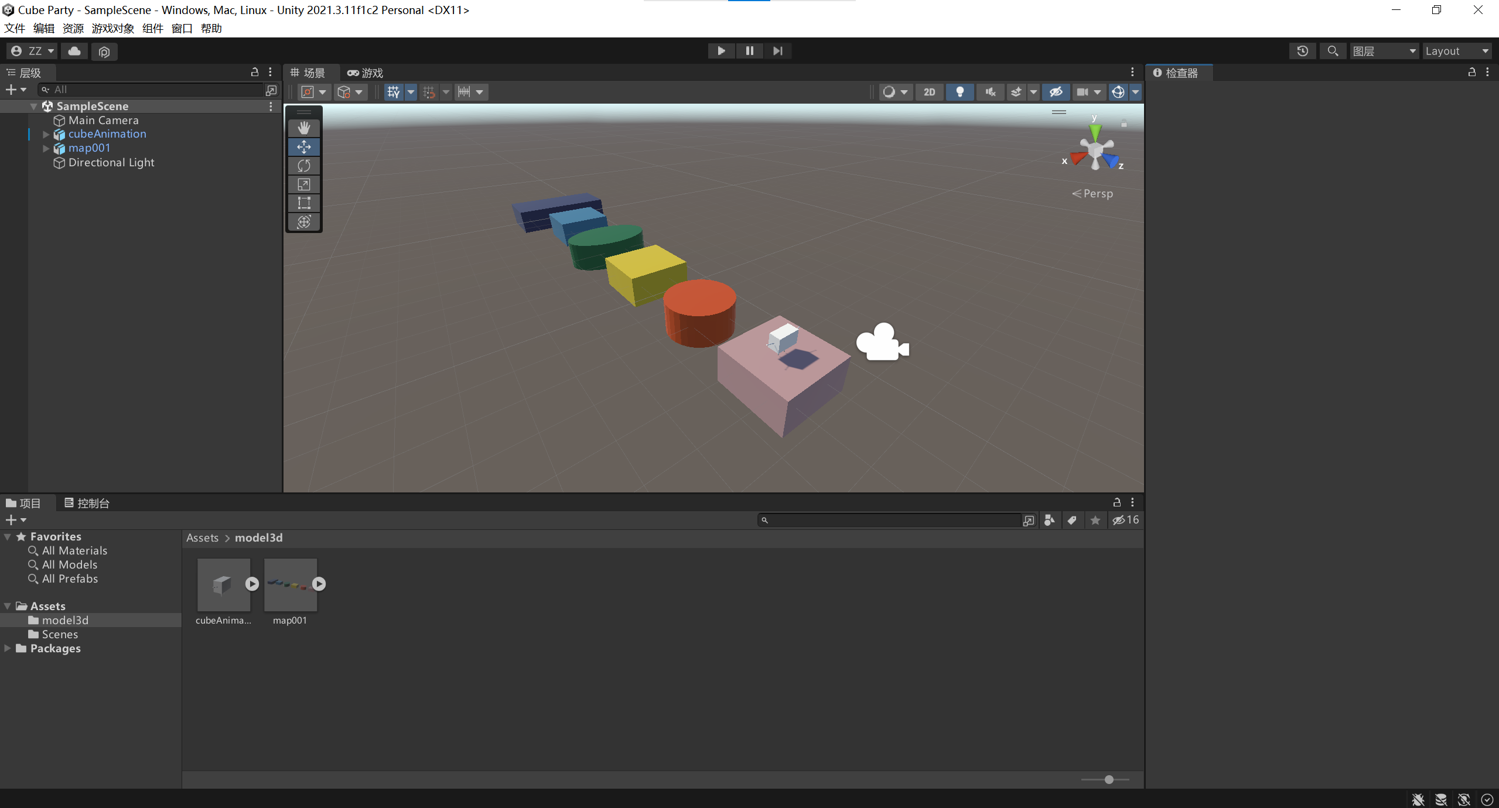
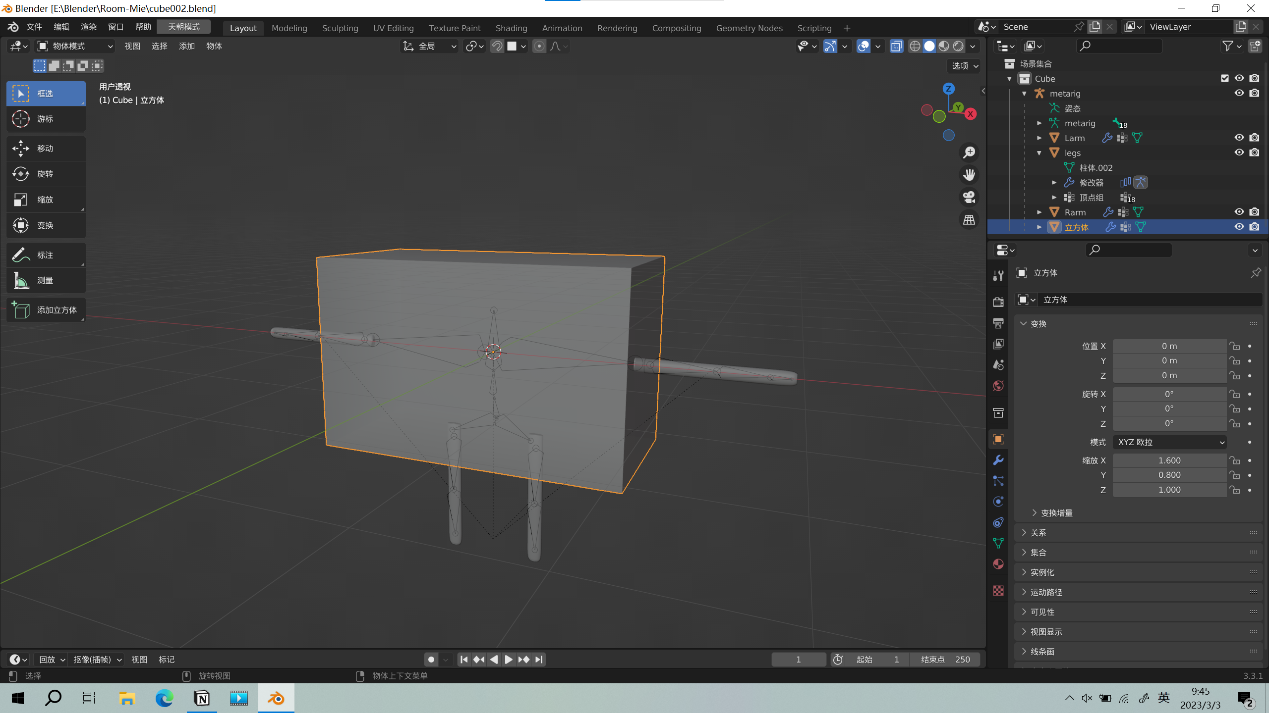
3
Methodology
Implement Software
Unity 3D
Game engine
Interactive real-time 3D platforms
Blender
Open-sourced 3D creation suite
Used for modeling

Slide 8
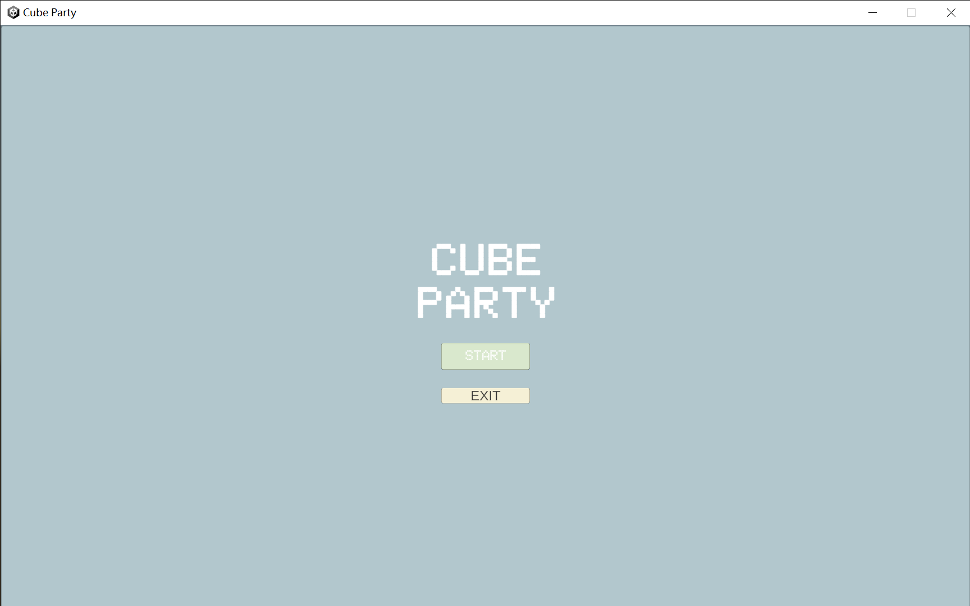
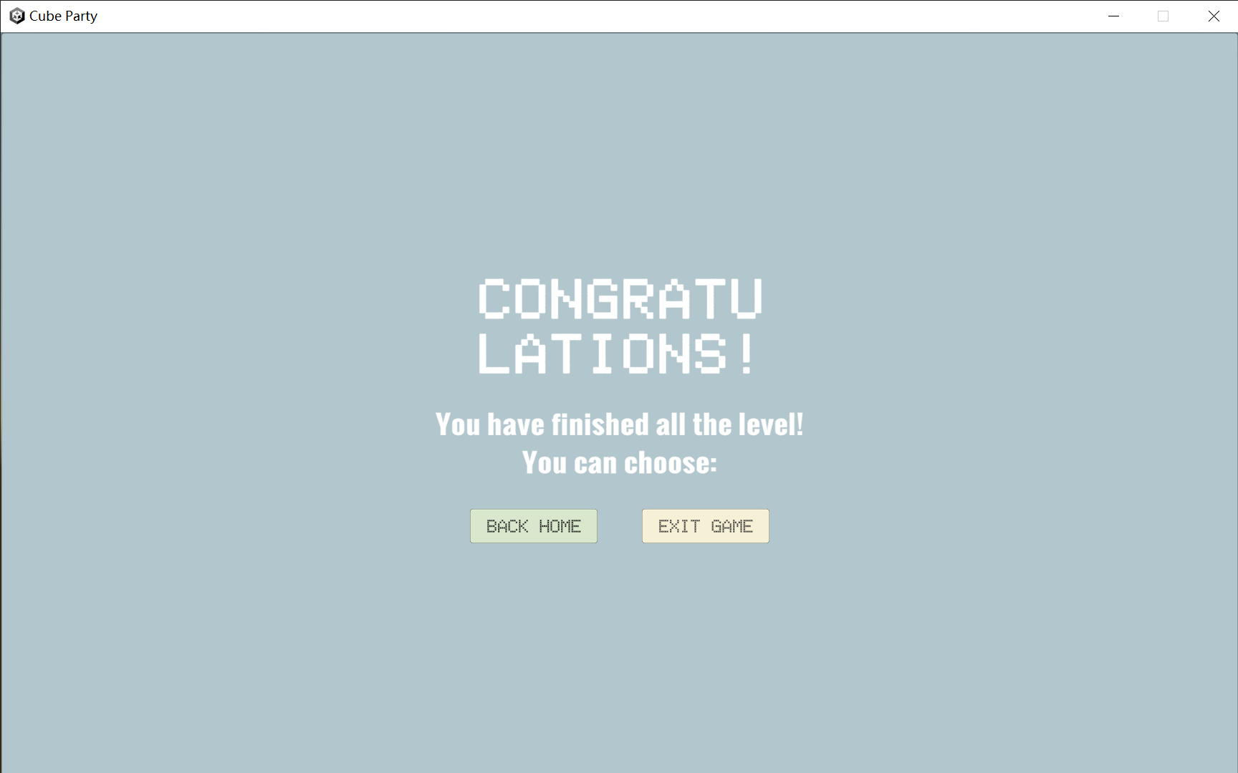
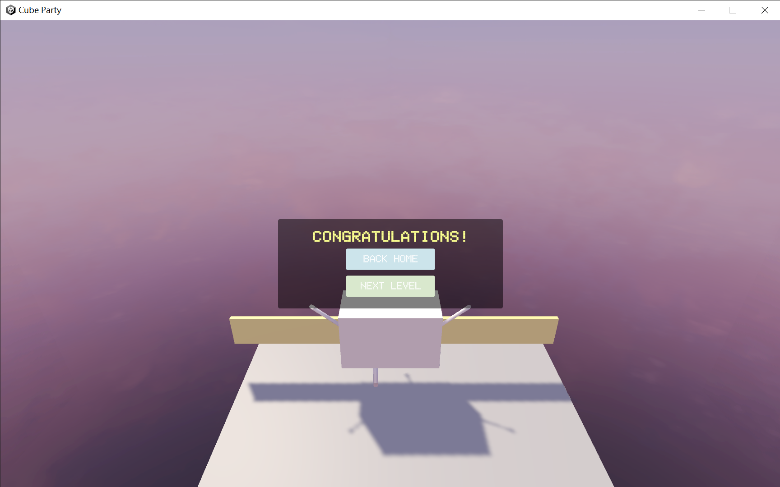
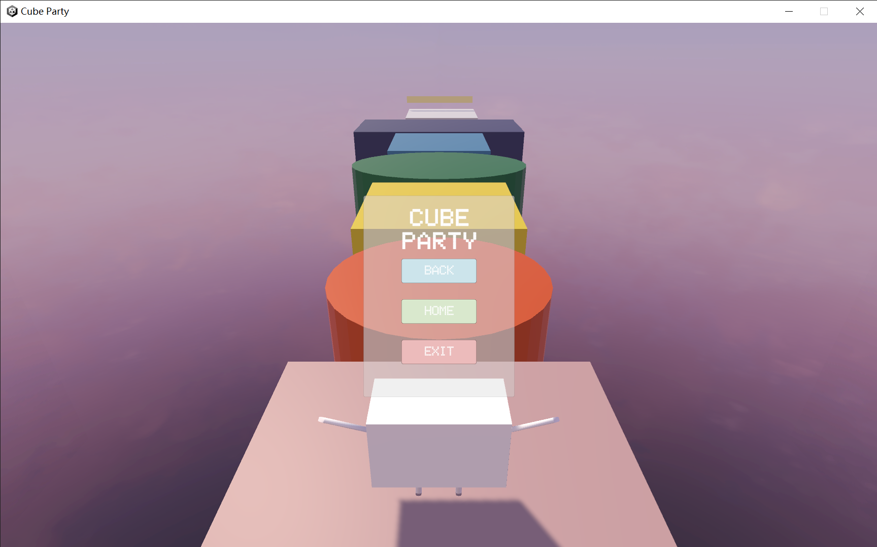
4
Implementation & Results
Interfaces & Levels
Start Interface
The first level
The second level
End line pop up window
Esc pop up window
End Interface

Slide 9
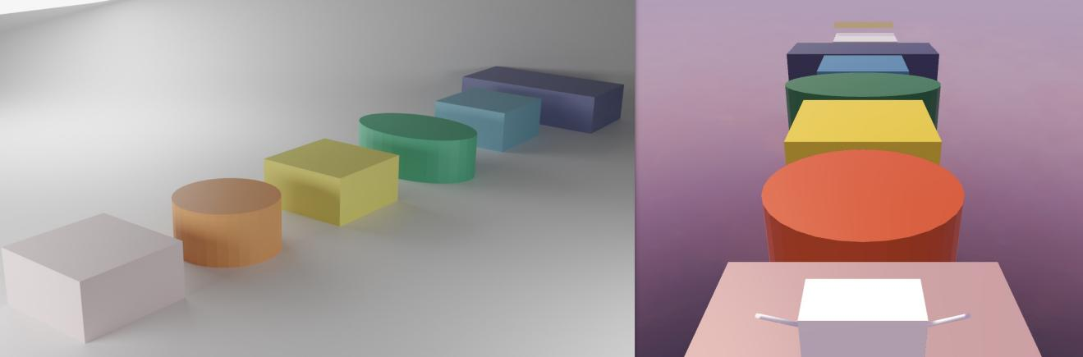
4
Implementation & Results
Functional Results
Test bug analysis
Move & Animation
Jump
Esc key detect
Determination of death
Buttons in each interfaces
Finish line
Jump animation
Model effect different in Unity and Blender

Slide 10
5
Conclusion
Limitations from feedback
Future work
Only 1 model of character
Small maps
Too few levels
Operation is too simple
No background music and sound effect
More models of character
Bigger maps
More levels and maps
Addition of background music and sound effects

Slide 11
Thanks for Listening!
Enter Q & A Time

